Slide 1
Pattern-oriented Modeling:
The Jamaica Coffee Farm example
Part I: POM to design model structure

Slide 2
About this file
This file is provided by Steve Railsback as supplementary material to: Railsback, S. F. and V. Grimm. 2012. Agent-based and individual-based modeling: a practical introduction. Princeton University Press.
The file is a summary of: Railsback, S. F. and M. D. Johnson. 2011. Pattern-oriented modeling of bird foraging and pest control in coffee farms. Ecological Modelling 222:3305-3319. Read this reference for additional detail and justification.
You are welcome to copy, edit, and use this file (and the associated NetLogo file) for instructional purposes.
Some slides have ‘speaker notes’ with more information.
This file is copyrighted by Steven F. Railsback, 2015.
A NetLogo implementation of the coffee farm model is also available. The code is designed for reproducing the POM Phase II (theory development) analyses as an exercise.
For additional information, see:
http://www.railsback-grimm-abm-book.com
https://qubeshub.org/groups/abm

Slide 3
Background
Globally, coffee borer beetles (CBB) are the only significant pest on coffee.
Female beetles bore into coffee berries, then raise a brood inside the berry. This ruins the berry as a crop.
Matt Johnson discovered that N. American songbirds (such as black-throated blue warblers) that overwinter in Jamaica sometimes eat large numbers of CBB.
CBB are not sufficient to support birds by themselves, so other habitat that provides food for birds (e.g., forest, “trees” or forest fragments, shade coffee) is necessary to maintain bird populations so they can control CBB.
Shade coffee (grown under a tree canopy) provides bird habitat and has less CBB than sun (monoculture) coffee, but has lower production per hectare.
Notes:
For more detailed background on the land use-CBB-bird-coffee production story, read: Kellermann, J. L., M. D. Johnson, A. M. Stercho, and S. C. Hackett. 2008. Ecological and economic services provided by birds on Jamaican Blue Mountain coffee farms. Conservation Biology 22:1177-1185.

Slide 4
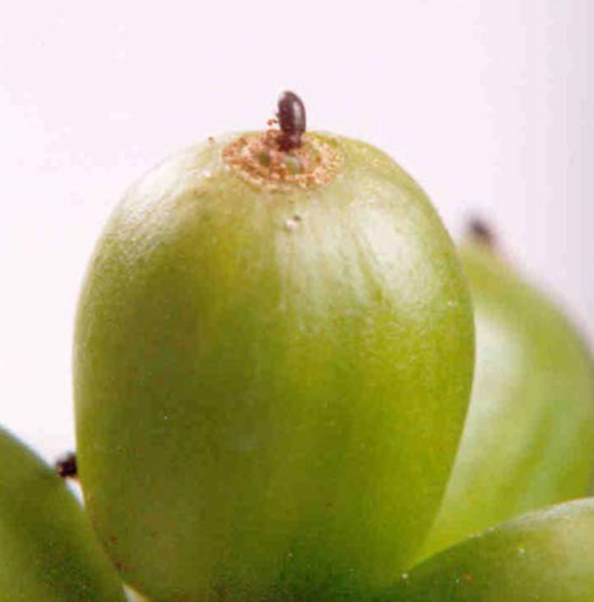
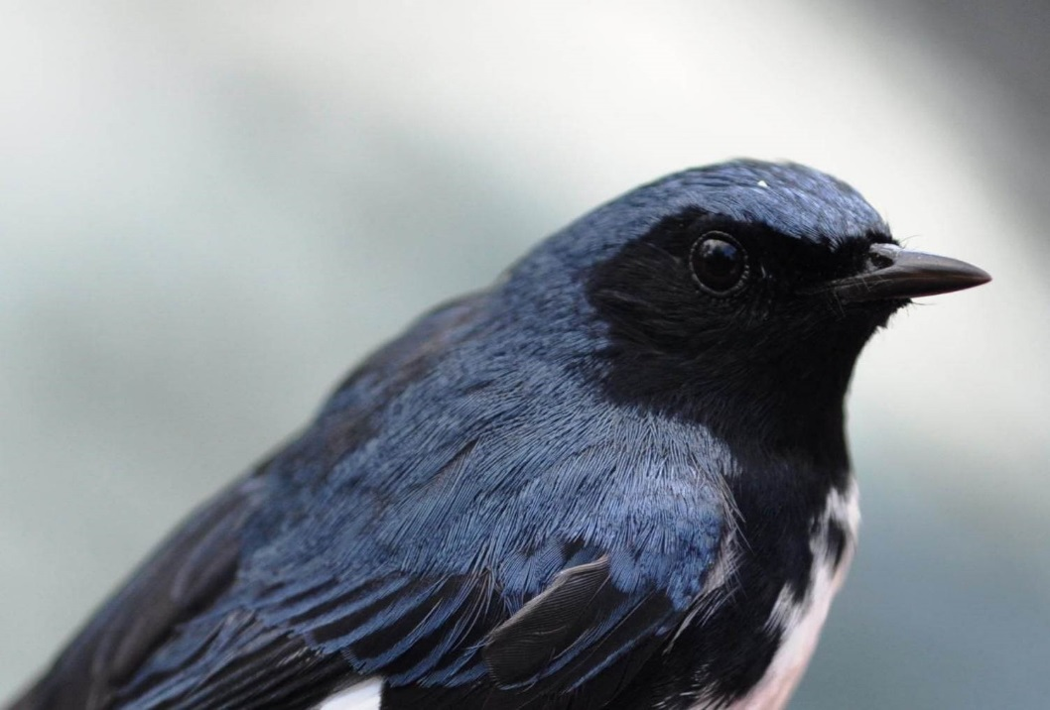
Birds, Beetles, and Coffee
Photo by M. Johnson
Photo from: Jaramillo, Juliana, et al. "Thermal tolerance of the coffee berry borer Hypothenemus hampei: predictions of climate change impact on a tropical insect pest." PLoS One 4.8 (2009): e6487.
Coffee borer beetle (CBB)
(bad guy)
Black-throated blue warbler
(good guy)
Notes:
The female CBB spends about a day drilling into a berry, which exposes her to predation by birds. The left photo shows one beetle on one coffee berry.

Slide 5
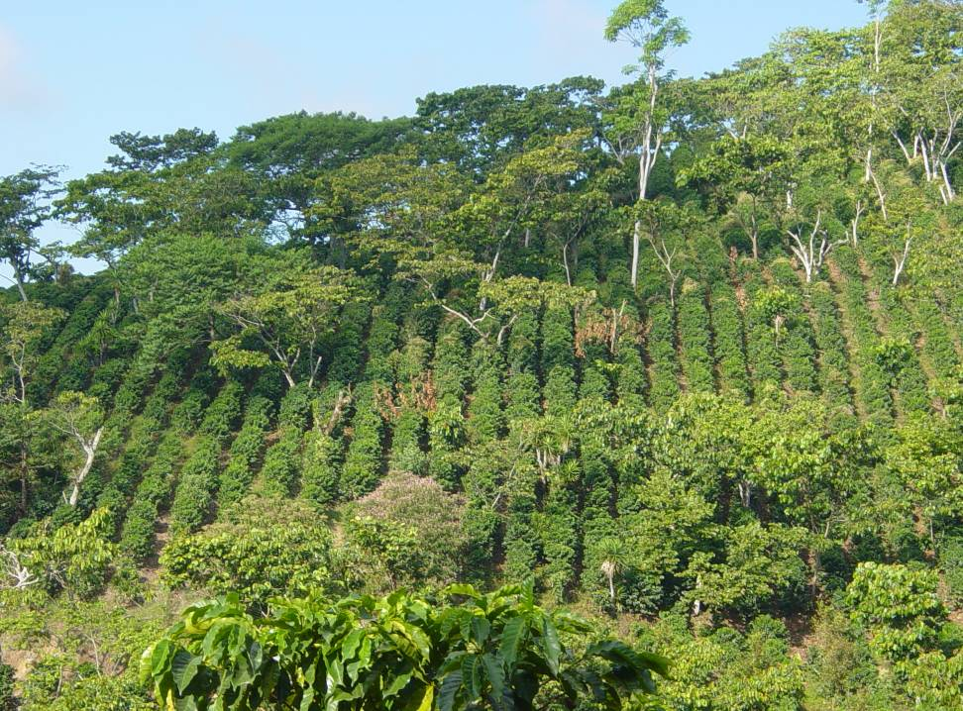
Coffee farms have diverse habitat
Coffee farm in Chiapas, Mexico, photographed by Brenda Lin
Notes:
This photo illustrates some of the land uses in the model: sun coffee, shade coffee (under trees), and “trees” (small fragments of forest trees). It also illustrates the small-scale variability in land uses.

Slide 6
Model purposes
To explore effects of changes in coffee farm management on bird populations and the pest control services birds provide.
In particular, to help us understand and predict how the relative area and spatial arrangement of several common habitat types, especially high- and low-shade coffee, affect local bird densities and the reduction of CBB infestation rates by birds.

Slide 7
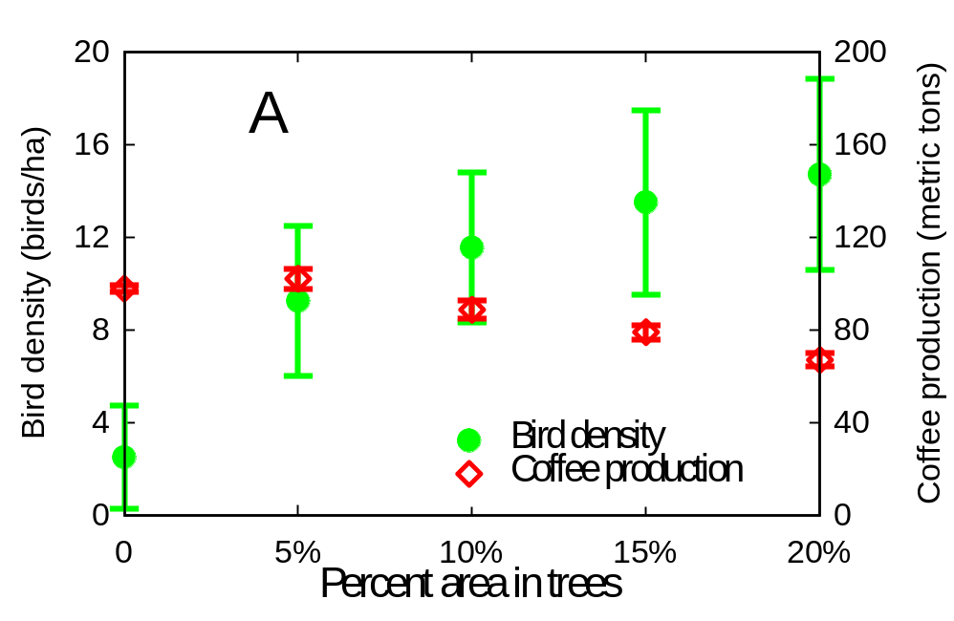
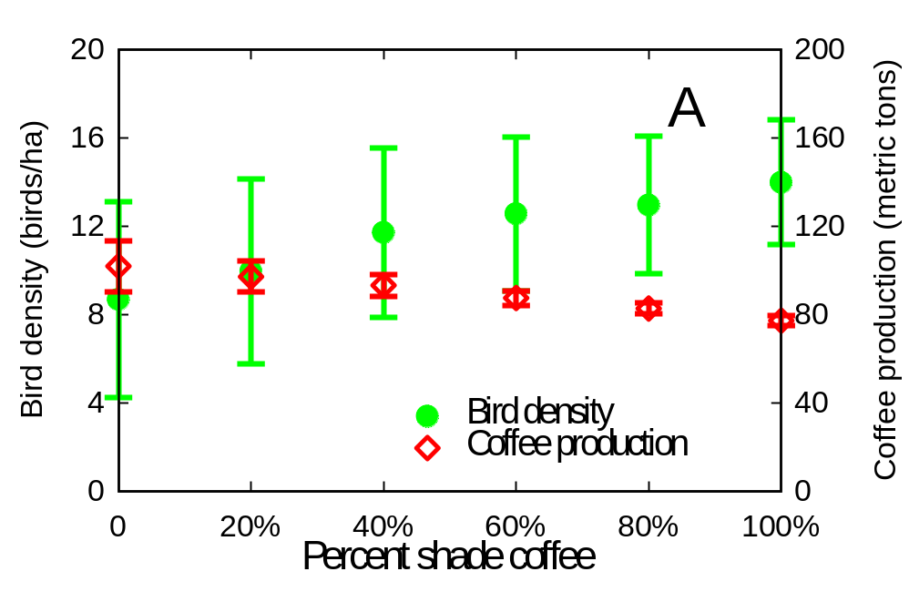
Model purpose--restated
??
??
Notes:
Another way to state the model’s purpose is to show the graphs that we eventually want to produce using the model. Here: how do (left axis) bird density and (right) production of uninfested coffee depend on (top) area of trees habitat and (bottom) percent of total coffee that is shade instead of sun-grown.

Slide 8
Pattern-Oriented Modeling
Phase 1: Use patterns to design the model
The first “filter” for deciding what to include in any model is the problem the model is to solve...
  include only stuff necessary to solve the problem
A clearly-stated problem is essential for designing a model... but for complex models it is not sufficient
  Too many ways to solve the same problem
  What entities, variables, processes, etc. really capture the system’s inner workings??

Slide 9
Phase 1: Use patterns to design the model
The model needs to include
  Processes that cause the patterns
  (especially: emergent processes)
  Structures & variables that are essential to the patterns
  The scales that patterns occur at
  (Little else--Leave out anything unimportant to the patterns)

Slide 10
Pattern-Oriented Modeling
First...
Identify “characteristic” observed patterns
  Patterns observed in the real system, that are related to the problem the IBM is to solve:
    Are driven by same individual and environmental processes
    Occur at same resolutions
    Capture the essence of the system you are modeling
  A variety of general patterns can be most useful

Slide 11
How to design the coffee farm model?
What “characteristic patterns” have we observed in the system?
What needs to be in the model so that these patterns could emerge?

Slide 12
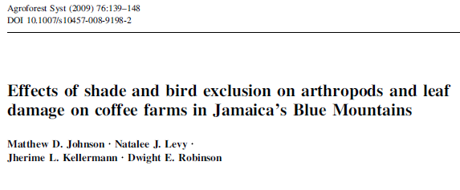
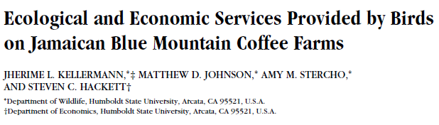
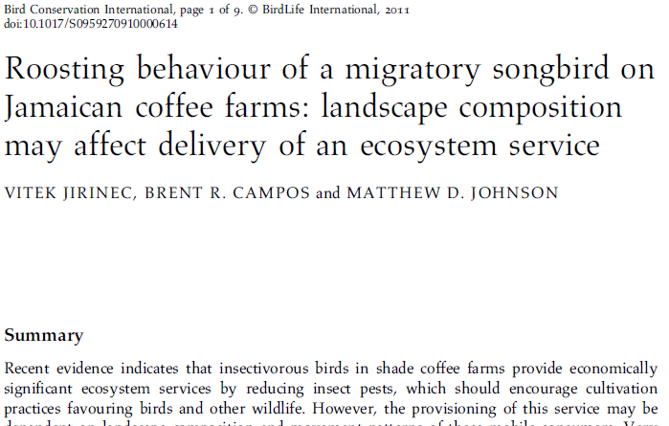
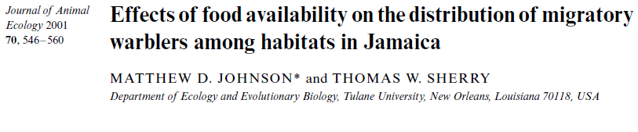
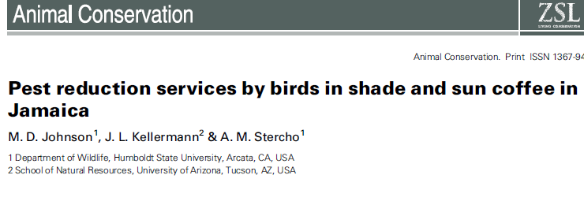
Notes:
Patterns were identified from a number of published studies and unpublished data from the Jamaica coffee farms (and other coffee production areas). See Railsback & Johnson 2011 (Ecological Modelling) for which papers support which patterns.

Slide 13
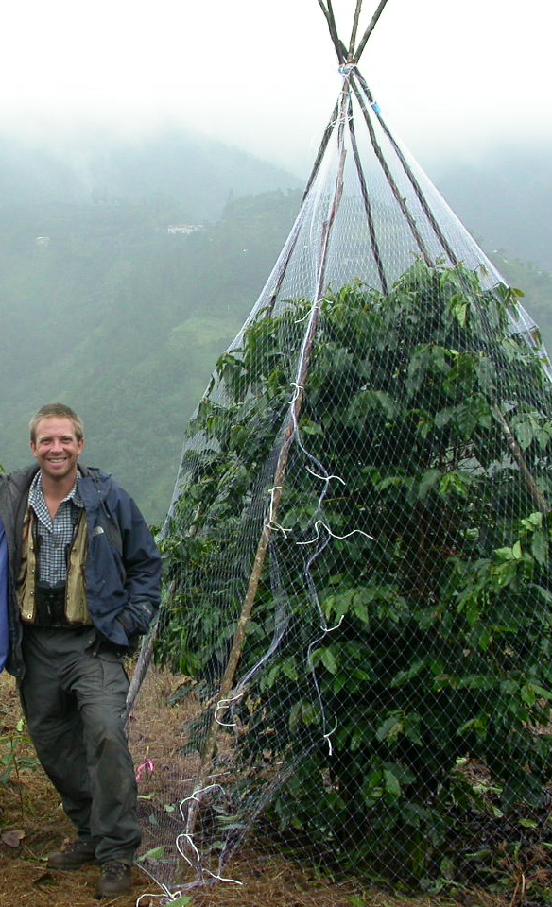
Pattern 1:
CBB infestation rates increase over the coffee growing season and are higher on coffee bushes that birds are excluded from
Notes:
The photo shows Matt Johnson and an “exclosure” that keeps birds out and lets bugs into a coffee bush.

Slide 14
Pattern 2:
In “exclosures”, CBB infestation rates are higher in sun-grown coffee than in shade coffee

Slide 15
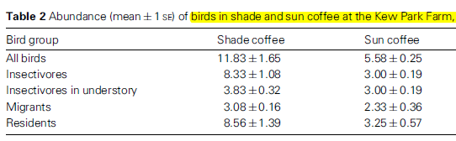
Pattern 3:
Bird densities are 2-3 times higher in shade coffee vs. sun coffee

Slide 16
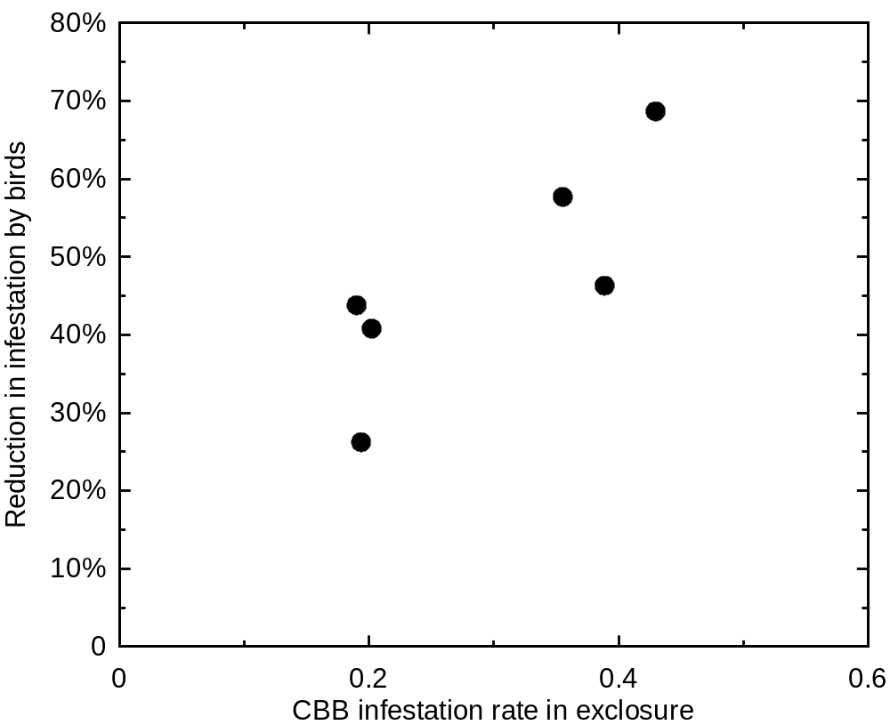
Pattern 4:
The percent reduction in CBB infestation by birds is higher where CBB infestation rate is higher

Slide 17
Pattern 5:
Bird densities increase rapidly when there is a short-term, sharp increase in food availability (a “bug irruption”)

Slide 18
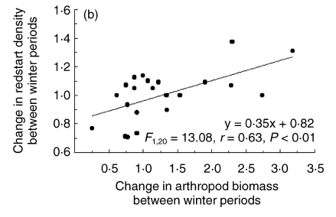
Pattern 6:
Changes in bird densities over a season are related to food availability: bird density went up when food went up, and vice versa

Slide 19
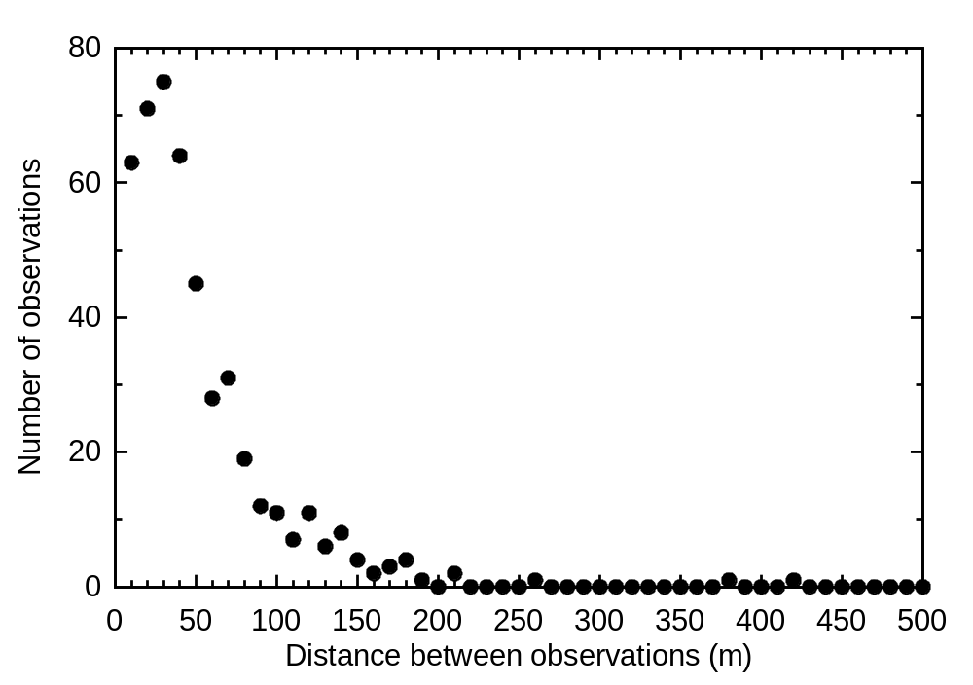
Pattern 8:
Bird movement distances measured at an hourly scale follow a log-normal distribution:

Slide 20
Pattern 9:
Consumption of CBB by birds is episodic:
  CBB make up only 8% of overall food, but
  For short periods, CBB can be almost 100% of a bird’s diet

Slide 21
What do these patterns tell us about a model’s structure??
Model dimensions and scales:
  Does the model need to represent time? space?
  at what resolutions?
Notes:
At this point, go back through the patterns and have students answer these questions.

Slide 22
What do these patterns tell us about a model’s structure??
Many patterns are differences among habitat types, so the model must be spatial
  at resolution fine enough (5 m²) to represent the small patches of vegetation that typify the farms
Many patterns are changes over time, so model must be dynamic
Bird foraging is the key adaptive behavior, and birds move often, so we need a short time step
(1 min)
Notes:
These are answers to the questions about model dimensions and scales.

Slide 23
What do the patterns tell us about what things the model needs to represent?
Notes:
At this point, go through the patterns again and look for entities and mechanisms that must be in the model to make it possible for the model to reproduce the patterns.

Slide 24
What do the patterns tell us about what things the model needs to represent?
CBB infestation rate
(% of coffee berries with beetles in them)
  varying over time and between shade- and sun coffee
NOT CBB population dynamics
Exclosures (three patterns are results of exclosure experiments)
Bug irruptions (pattern 5)
Notes:
These are answers to the question of what things need to be in the model.

Slide 25
What do the patterns tell us about what processes need to be modeled?
Bird foraging:
  Selection of habitat
  Selection of food (bugs vs. CBB)
Pattern 6:
Mortality / emigration
due to food shortage
Notes:
These are answers to the question of what processes need to be in the model.
Pattern 6 is about changes in bird density—because the model represents the non-breeding season, density can only change due to mortality or emigration/immigration. The pattern is a response to food availability, so mortality / emigration must be related to food.

Slide 26
So—
Coffee farm model scales and entities:
Time scales:
  Daily time step but birds can move and switch food every minute
Cells:
  Are 5 m in width, 200 x 200 cells (100 ha)
  Are each one of 6 habitat types, initialized into patches
  Have variables for bug availability and CBB infestation rate
Birds: 3000 initial birds with variables:
  Location (which cell)
  Energy level

Slide 27
So—Coffee farm model processes
(Daily schedule of model events):
Bug production
CBB infestation update
Birds reset energy level to empty
Birds forage (once per minute, up to 12 hrs, until they obtain daily energy need)
Birds may starve if they do not obtain daily energy need
Notes:
This is the end of the discussion of POM phase 1: Model design.

Slide 28
Pattern-oriented Modeling:
The Jamaica Coffee Farm example
Part II: POM to develop theory for adaptive behavior
Notes:
In Phase 1 of POM, we decided that we need to represent one bird behavior: foraging (selecting the patch and food source, bugs or CBB). Now, we need to know how to model foraging.
It is good to instill a sense of skepticism about modeling behavior: IBMs cannot possibly be useful if we do not know how valid or useful their submodels for individual behavior are.

Slide 29
The pattern-oriented theory development cycle
Proposed theories: alternative traits for a key individual behavior
IBM
How well does IBM reproduce observed patterns?
Empirical literature, research
Characteristic patterns of emergent behavior
Notes:
This is Fig. 19.1 of Railsback & Grimm 2012.

Slide 30
Pattern-oriented analysis of foraging behavior theory for the coffee farm model
Patterns observed on Jamaican coffee farms | Theory 1: | Theory 2: | Theory 3: | Theory 4:
Pattern 1: | ✓ | ✓ | ✓
Pattern 2: |  |  | ✓ | ✓
Pattern 3: |  | ✓ | ✓
Pattern 4: |  | ✓ | ✓ | ✓
...
Pattern 9:
Notes:
Our goal is to fill out this table: For each of four alternative theories of how birds forage, how many of our observed patterns does the model reproduce?

Slide 31

Foraging in the coffee farm model
How do individual birds decide:
  which habitat cell to forage in
  whether to eat CBB or other
  food (“bugs”)
In a population context:
  Food eaten by one bird is no longer available to others
  So behavior affects resources, which affect behavior
Scales:
  5 × 5 meter cells
  1 minute time step, up to 12 hours per day
Notes:
This is a reminder of exactly what our foraging submodel must do.

Slide 32
Four alternative foraging theories
Random (a “null” theory):
  randomly choose one of 9 neighborhood cells
  eat bugs or CBB (the most profitable)

Slide 33
Four alternative foraging theories
Random
Optimal departure (based on Charnov 1976 “marginal value theory”)

Slide 34
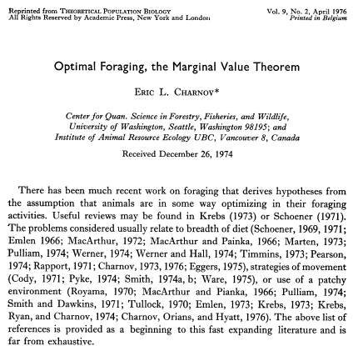
Charnov (1976) “Marginal value theorem”
(cited ~4000 times)
The theory: Maximize intake by foraging in one patch until food is depleted to landscape average
Problems: ??
Notes:
We wanted to use some classical foraging theory, and this is the most classic—a very early example of optimal foraging theory. But--- it does not work well in an IBM of even limited realism. Try to make students figure out why.

Slide 35
Charnov (1976) “Marginal value theorem”
The theory: Maximize intake by foraging in one patch until food is depleted to landscape average
Problems:
  Doesn’t say where to move to
  What is “landscape average” when food is constantly being depleted by competitors?
  Landscape average food availability may not be sufficient to keep the individual alive
Notes:
Main issue: this theory is about when to leave a patch, but we need theory about where to go next.

Slide 36
Four alternative foraging theories
Random
Optimal departure (based on Charnov 1976 “marginal value theory”):
  Stay in a cell until food is depleted so that bird cannot meet its daily intake requirement
  Then move randomly to a neighbor cell
Notes:
So this is the rule we made up that is based on Charnov’s theory. See R&J 2011.

Slide 37
Four alternative foraging theories
Random
Optimal departure
Optimal cell (short range):
  Always select cell with highest intake rate
  among the 9 neighborhood cells

Slide 38
Four alternative foraging theories
Random
Optimal departure
Optimal cell (short range):
Optimal cell (long range):
  Always select cell with highest intake rate
  within a radius of 100 meters

Slide 39
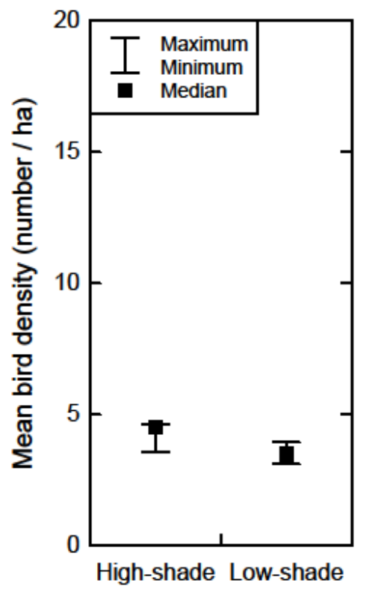
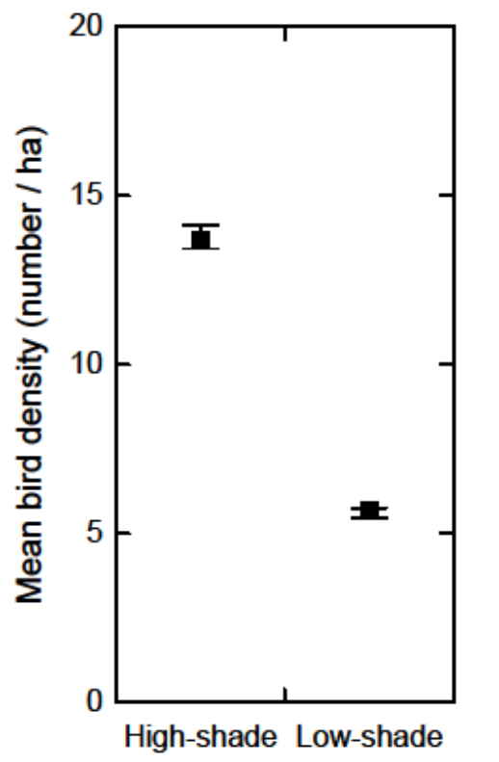
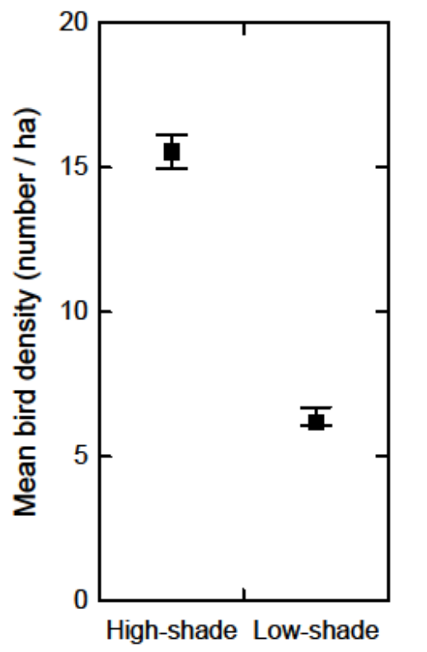
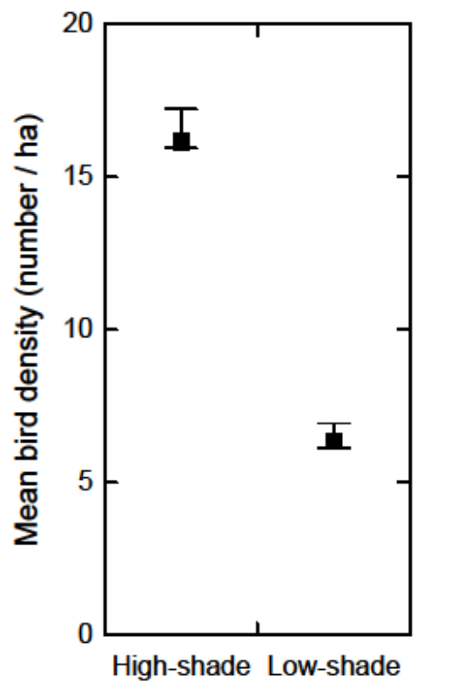
Pattern 3: Bird densities are higher in shade vs. sun coffee
Shade Sun
Shade Sun
Shade Sun
Shade Sun
Random
Optimal
departure
Optimal cell-
short range
Optimal cell-
long range
Notes:
Starting here are model results testing its ability to reproduce the observed patterns under the four alternative theories. Not all patterns and theories are presented, only the most important.

Slide 40
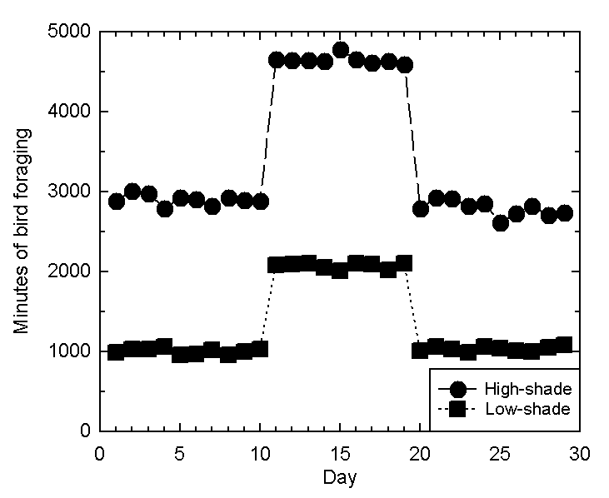
Pattern 5: Birds respond to local food irruptions
Optimal cell-
short range

Slide 41
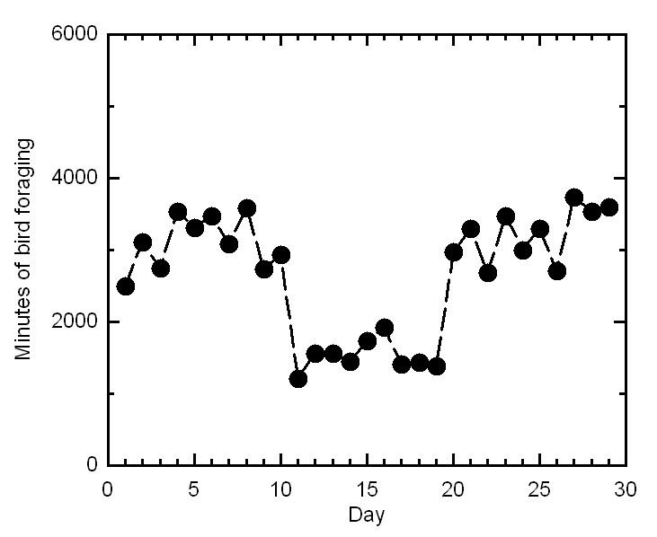
Pattern 5: Birds respond to local food irruptions
Optimal
departure
Birds cannot seek high-food cells
Birds that randomly enter high-food cells finish their daily feeding sooner

Slide 42
Pattern 8: Bird movement distances, measured hourly, follow a log-normal distribution

Slide 43
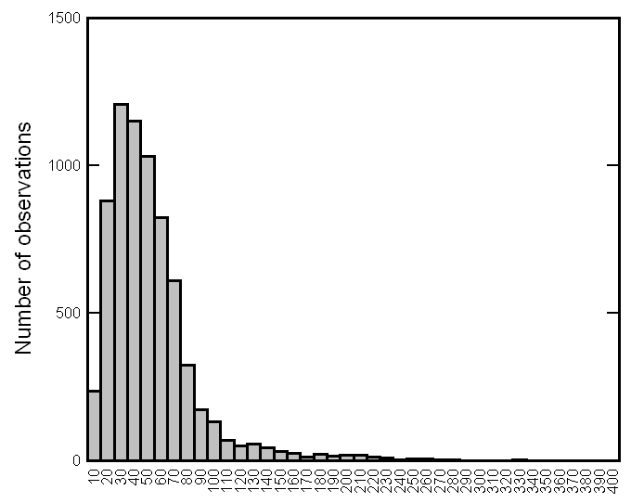
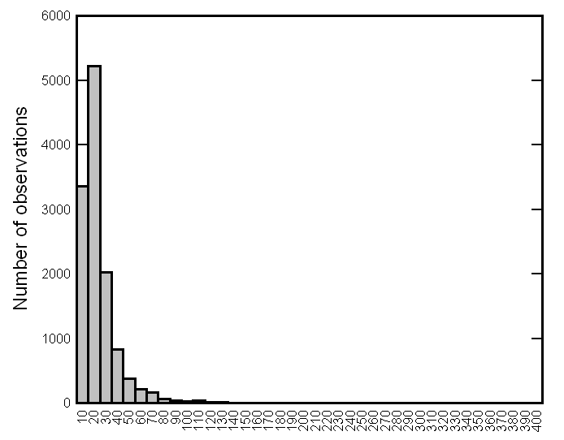
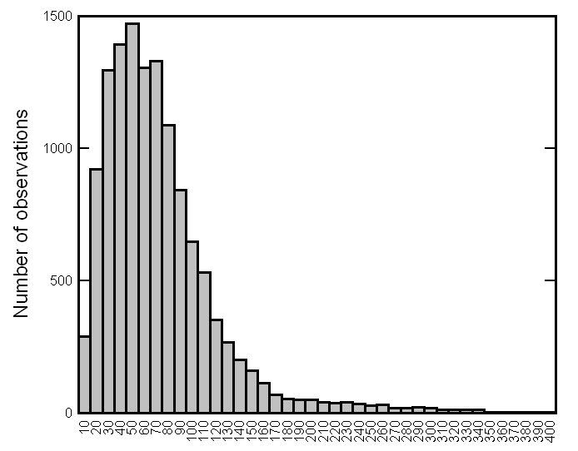
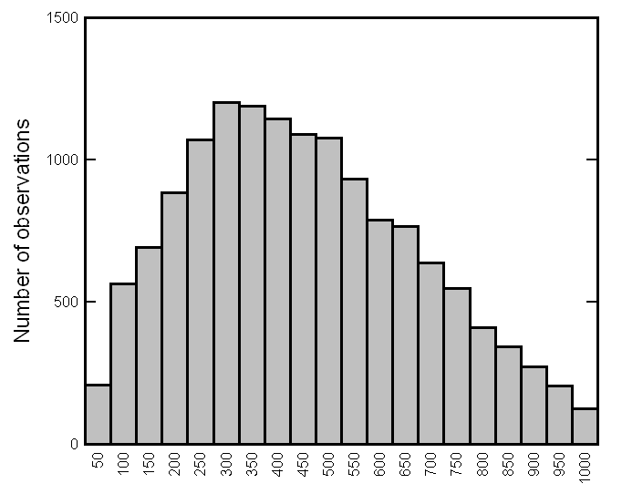
Pattern 8: Log-normal movement distances
Random
Optimal
departure
Optimal cell-
short range
Optimal cell-
long range

Slide 44
Final score for hypothesized behaviour models:
Patterns | Random | Optimal departure | Optimal destination- short distance | Optimal destination- long distance
1) Pest reduction by birds | ✓ | ✓ | ✓ | ✓
2) Infestation higher in sun coffee | ✓ | ✓ | ✓ | ✓
3) Bird densities higher in shade coffee |  | ✓ | ✓ | ✓
4) Bird effect increases with infestation rate | ✓ | ✓ | ✓ | ✓
5) Higher bird density during food irruptions |  |  | ✓ | ✓
6) Bird density varies with food availability | ✓ | ✓ | ✓ | ✓
8) Log-normal movement distance distribution | ✓ |  | ✓
9) Episodic pest consumption | ✓ | ✓ | ✓ | ✓

Slide 45
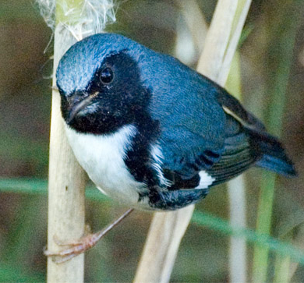
Conclusions about foraging theory for the coffee farm model
Theory must assume birds have the ability to detect and seek profitable foraging locations
Over short (not long)
distances

Slide 46
General conclusions about behavior theory for IBMs
The use of multiple observed patterns to test alternative hypotheses is a productive way to develop theory for individual behavior
Classical behavior theory often fails in individual-based population models
  More realistic level of complexity
  Feedbacks:
  Behavior affects competition affects behavior

Slide 47
Some conclusions from this model:
Intact forest was less important for bird populations and pest control than shade coffee or “trees” habitat patches
Even relatively small areas of tree and shade coffee habitat can support enough birds to suppress CBB in sun coffee
(highest coffee production at 5% trees habitat)
Fragmentation of tree habitat was unimportant
When bug-productive habitat was lacking, converting small areas of sun coffee to shade coffee produced a net increase in uninfested coffee
Too much tree & forest habitat reduced consumption of CBB by birds – too much other good food

Slide 48
Related references
This model was used to analyze effects of land use on bird populations and coffee production in:
  Railsback, S. F. and M. D. Johnson. 2014. Effects of land use on bird populations and pest control services on coffee farms. Proceedings of the National Academy of Sciences of the United States of America 111:6109-6114.
The model was based on many field studies, including:
  Johnson, M. D. 2000. Effects of shade-tree species and crop structure on the winter arthropod and bird communities in a Jamaican shade coffee plantation. Biotropica 32:133-145.
  Johnson, M. D., J. L. Kellerman, and A. M. Stercho. 2010. Pest reduction services by birds in shade and sun coffee in Jamaica. Animal Conservation 13:140-147.
  Johnson, M. D., N. J. Levy, J. L. Kellerman, and D. E. Robinson. 2009. Effects of shade and bird exclusion on arthropods and leaf damage on coffee farms in Jamaica's Blue Mountains. Agroforestry Systems 76:139-148.
  Johnson, M. D. and T. W. Sherry. 2001. Effects of food availability on the distribution of migratory warblers among habitats in Jamaica. Journal of Animal Ecology 70:546-560.
  Kellermann, J. L., M. D. Johnson, A. M. Stercho, and S. C. Hackett. 2008. Ecological and economic services provided by birds on Jamaican Blue Mountain coffee farms. Conservation Biology 22:1177-1185.
  Jirinec, V., B. R. Campos, and M. D. Johnson. 2011. Roosting behaviour of a migratory songbird on Jamaican coffee farms: landscape composition may affect delivery of an ecosystem service. Bird Conservation International 21:353-361.
A related study in Costa Rica:
  Karp, D. S., C. D. Mendenhall, R. F. Sandí, N. Chaumont, P. R. Ehrlich, E. A. Hadly, and G. C. Daily. 2013. Forest bolsters bird abundance, pest control and coffee yield. Ecology Letters 16:1339-1347.

